Slide 1


Slide 2
Presentation on:- Principles of web graphics design – browser safe colors, size, resolution, background, anti-aliasing
Presented by:-
Name:- Rupak parajuli
Roll-no:- 21 (twenty-one)

Slide 3
Table of content:-
1. Principles of web graphics design,
2. browser safe colors,
3. size,
4. resolution,
5 background,
6. anti-aliasing

Slide 4
Graphic design:-
Graphic design is a craft where professionals create visual content to communicate messages. By applying visual hierarchy and page layout techniques, designers use typography and pictures to meet users’ specific needs and focus on the logic of displaying elements in interactive designs, to optimize the user experience.

Slide 5
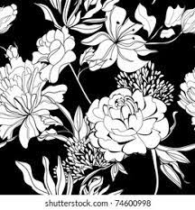
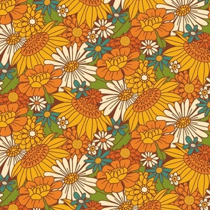

Slide 6
Principles of web graphics design:-
1. Balance
2. Alignment
3. Hierarchy
4. Contrast
5. Rhythm
6. Proximity
7. Colour and space

Slide 7
Balance:-
This refers to the distribution of the graphic design elements, such as shapes, text boxes, and images, of a design evenly throughout a certain layout. Designers can choose between a balanced (stable) design or an off-balanced (dynamic) layout. In the context of graphic design, balance is of three types.
i. Symmetrical:-
ii. Asymmetrical:-
iii. Radial:-

Slide 8
i. Symmetrical:-
This type of design is formed along a vertical axis and or horizontal axis, where the weight of the elements is evenly divided into both sides of the layout.
ii. Asymmetrical:-
This type of balance employs scale, contrast andcolorr to even out the flow of a layout. It is usually found in websites, where two sides of a webpage differ from each other but contain similar elements.
Iii. Radial:-
Here, the elements of a design are placed in a circular pattern on the layout. This provides a sense of movement and dynamism to the eyes of the viewer.

Slide 9
Alignment:-
This fundamental aspect of a design which creates a visual connection between elements such as images, shapes or blocks of texts. Alignment helps develop a sharp and ordered appearance by eliminating any distortion within the layout. It represents the scale of each element by comparing their proportion and focusing on the elements that can have a strong impact on users.

Slide 10
Hierarchy:-
This method combines two aspects, dominance and priority, giving extra weight to certain elements of a design over others. It helps brands convey their message to the audience by focusing on a particular element of the design. Hierarchy can be achieved by:
Highlighting the title using large or bold fonts;
Placing the key message at a higher level than other elements;
Adding shapes to frame the focal view;
Implementing detailed and colourful visuals.

Slide 11
Contrast:-
Contrast is an important principle in any form of visual art as it guides the customer’s attention to the key elements of a design. It is essential for maintaining the distinction between similar elements in a design, thereby enhancing a layout’s overall legibility. Contrast is formed when design elements are placed in opposition on a layout, for example:
Dark vs light;
Thick vs thin;
Contemporary vs traditional;
Large vs small.

Slide 12
Rhythm:-
Rhythm brings together different elements to create a more organized and consistent look. Repetition of certain elements such as logos or color can help make a brand easily recognizable and strengthen the overall look. Rhythm is classified into two types:-
Fluid – This adds a significant amount of variation to the design, keeping the flow in a single direction.
Progressive – Progressive rhythm is based on a clear sequence which controls the visual movement of the audience between the different elements.

Slide 13
Proximity:-
Proximity helps in decluttering the overall design by creating a relationship between related elements. It forms a visual connection among important design factors such as colour, font, type or size, ensuring the layout is balanced to form a perfect design. It enables the audience to have a pleasant overview of what they are looking at, thereby offering a good user experience.

Slide 14
Color and space:-
Choosing the right colour can help define the tone of the design. Designers can choose from a wide range of colour combinations for the background and text of the layout. Space refers to the area around or between the various elements of the design. It can either be used to create shapes or highlight the important aspects of a design. Graphic designers use a colour palette to choose colours that can create contrast or even work together to complement other elements.

Slide 15
Browser-safe Colors:-
Browser-safe colors are expressed as amounts of RED, GREEN and BLUE in hexadecimal code (HEX) and always in this order. In the accompanying chart, the HEX color codes are compared with RGB values and percentages of each color. In the hexadecimal system, which is base 16, there are sixteen symbols: 0, 1, 2, 3, 4, 5, 6, 7, 8, 9, A, B, C, D, E, and F. Browser-safe colors are a very limited part of the spectrum possible on a monitor; 8-bit monitors are limited to displaying 256 colors, and the system software and browsers reserve up to 40 colors for their own use (256-40=216). The charts below present a complete palette of the 216 possible combination of 6 browser-save HEX codes taken three at a time. A 16-bit monitor can display 65,536 colors, and a 24-bit monitor, 16.7 million colors.

Slide 16
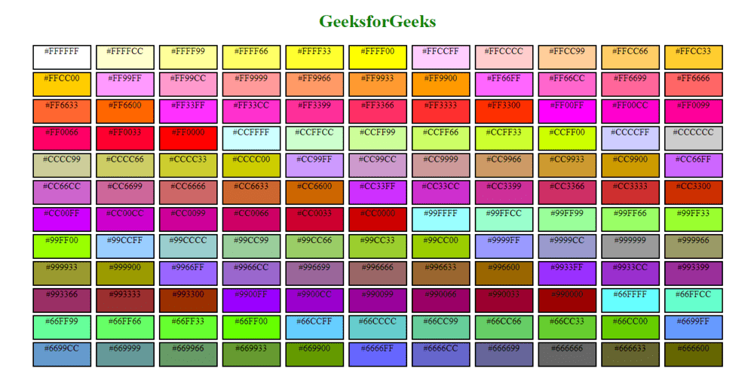
Some Browser-safe Colors:-

Slide 17
Size:-
Size is simply how small or big an element is in relation to other objects within a design. Generally, we use size to make a particular element stand out or to give it importance. However, size becomes a much more powerful design tool when it is considered alongside scale.

Slide 18
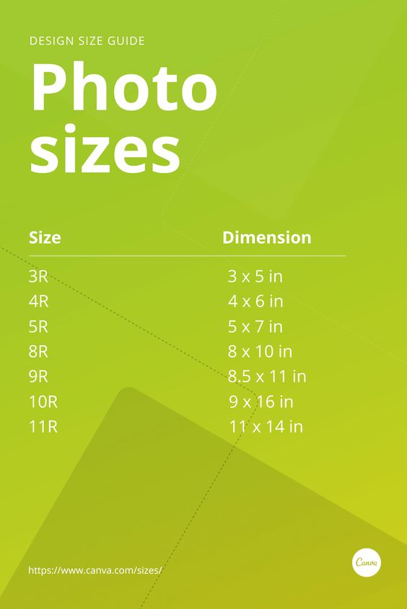

Slide 19
Resolution:-
Resolution indicates the number of pixels that are displayed per inch for an image (or pixels per centimeter). Most computer monitors display at resolutions of 72 pixels per inch or 96 pixels per inch. If an image is 72 pixels wide, then it will display as 1 inch big on a monitor that is set to a resolution of 72 pixels/inch. It is important to remember that for computer graphics, a higher resolution (pixels/inch) does not mean a higher quality image. What is important is the total size, in pixels, of the image.

Slide 20
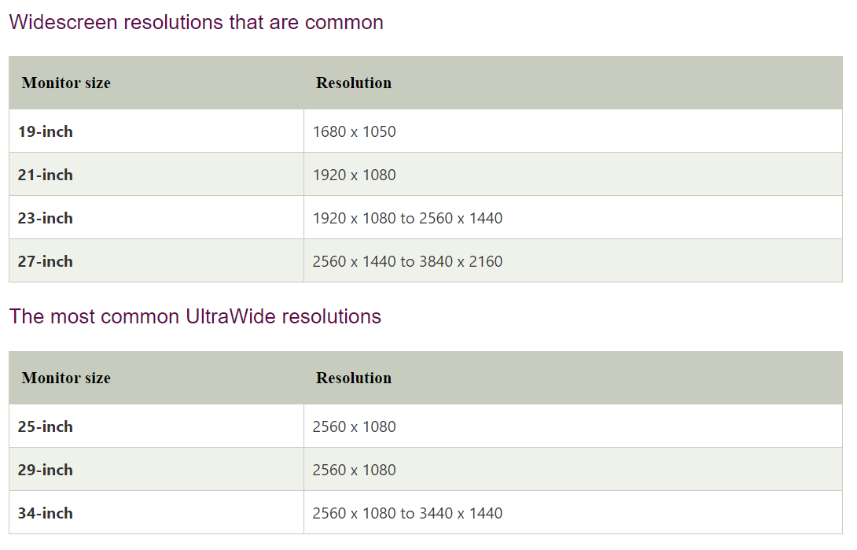

Slide 21
Backgrounds:-
Backgrounds are graphic design components that add ambiance to a photograph or picture to produce beautiful images or posts with unique backdrops. Different individuals and organizations can use the visual design element to develop various templates and layouts that suit their needs or use the background image for other graphic designs and documents.
Backgrounds are the foundation of a successful composition. Background textures and colors create depth and contrast, allowing graphics to stand out and get noticed.

Slide 22
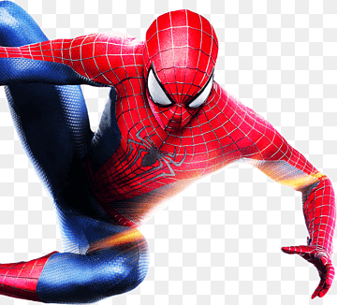


Slide 23
Antialiasing :-
Antialiasing is a technique used in computer graphics to remove the aliasing effect. The aliasing effect is the appearance of jagged edges or “jaggies” in a rasterized image (an image rendered using pixels). The problem of jagged edges technically occurs due to distortion of the image when scan conversion is done with sampling at a low frequency, which is also known as Undersampling. Aliasing occurs when real-world objects which comprise of smooth, continuous curves are rasterized using pixels.

Slide 24
The cause of anti-aliasing is Undersampling. Undersampling results in a loss of information about the picture. Undersampling occurs when sampling is done at a frequency lower than the Nyquist sampling frequency. To avoid this loss, we need to have our sampling frequency at least twice that of the highest frequency occurring in the object.

Slide 25
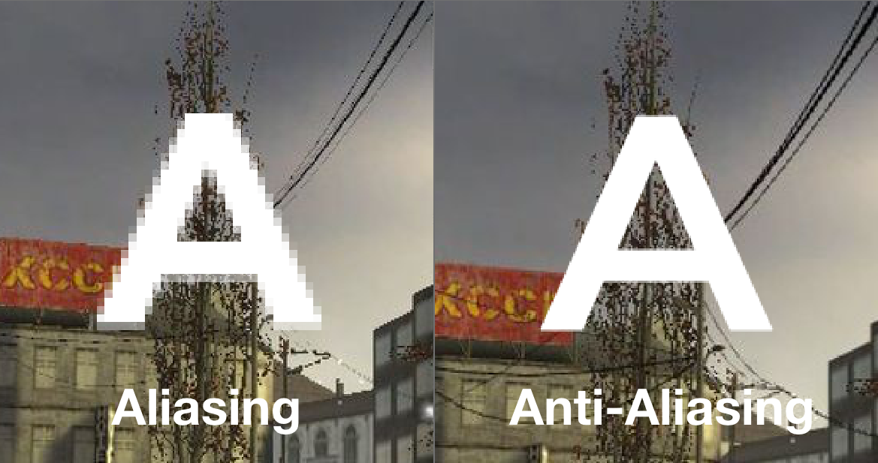

Slide 26
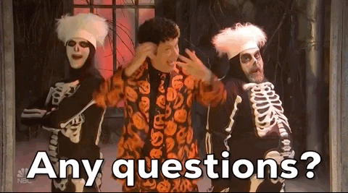

Slide 27


